Slide 1
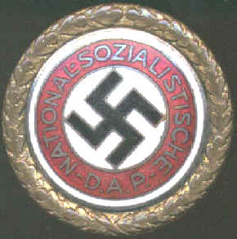
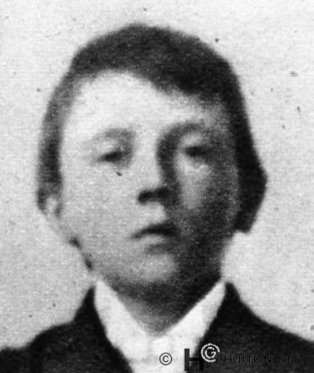
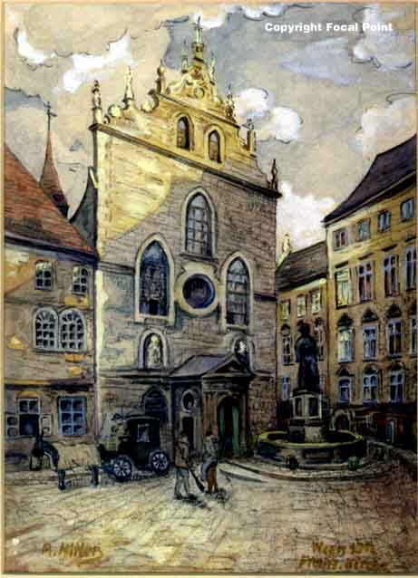
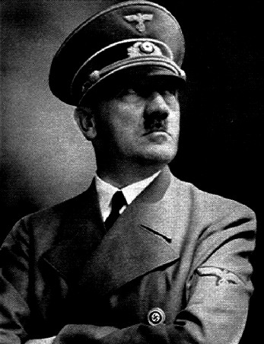
The Kapp Putsch and the Munich [Beer Hall] Putsch.
Boy Hitler

Slide 2
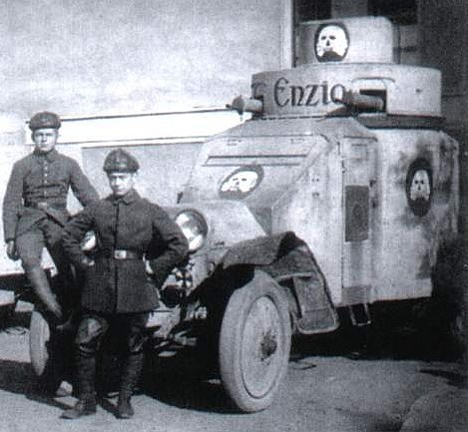
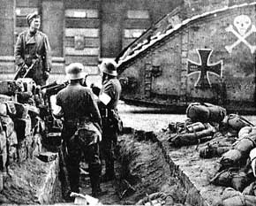
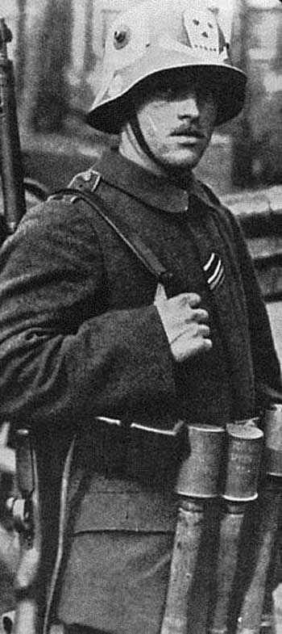
1918 and 1919
Kaiser Wilhelm abdicated on 10th November, 1918. The day after the armistice was signed by the new government called the Weimar Republic.
Germany was very unstable after the war and so was the new government. Many people called the new government the ‘November Criminals’.
Three months after the new government was set up the Spartacists [Communists] tried to overthrow it in January 1919. It failed because the new government used the Freikorps, groups of ex-soldiers, thugs, thieves and hooligans who wanted to fight against Communism.
FREIKORPS
IN BERLIN

Slide 3
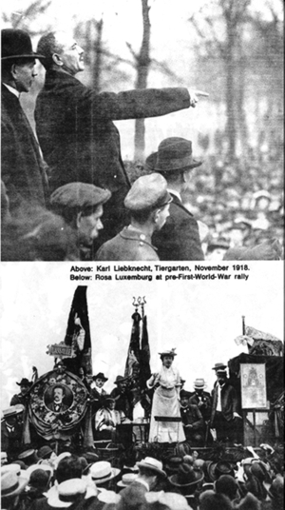
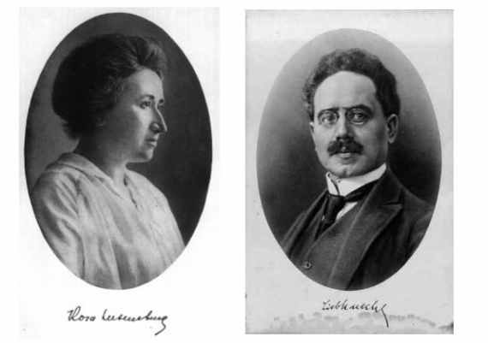
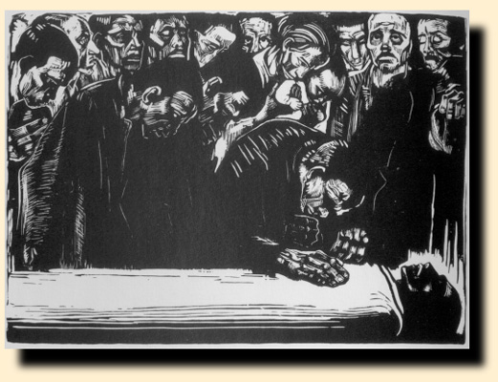
BUT, the Spartacists were not the only group of people who tried to overthrow the Weimar Republic government.
The second group of people who tried to overthrow the government was led by a man called Wolfgang Kapp in 1920. He wanted the return of the Kaiser and his uprising is called the Kapp Putsch.

Slide 4
WHAT IS A PUTSCH?
A putsch is the German word for a coup which is an attempt to take over a country by the use of force. It is the attempt to overthrow a government.

Slide 5
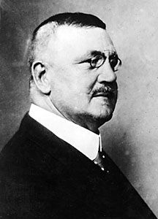
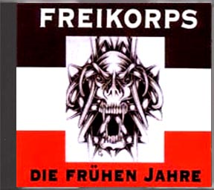
The Kapp Putsch [1920]
In March 1920 in Berlin, a group of 5,000 men tried to take over Germany. They were led by a man called Wolfgang Kapp. He was a right-wing extremist and a monarchist. He despised the Treaty of Versailles.
In this second uprising against the German government, Friedrich Ebert could not use the Freikorps like he had against the Spartacist uprising in 1919. That was because this time, it was the Freikorps that were doing the revolting!
The Freikorps wanted what Wolfgang Kapp wanted and so they followed his orders and fought against the Weimar Republic.
Wolfgang Kapp

Slide 6
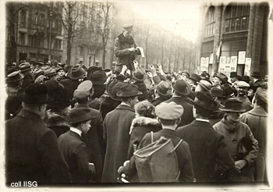
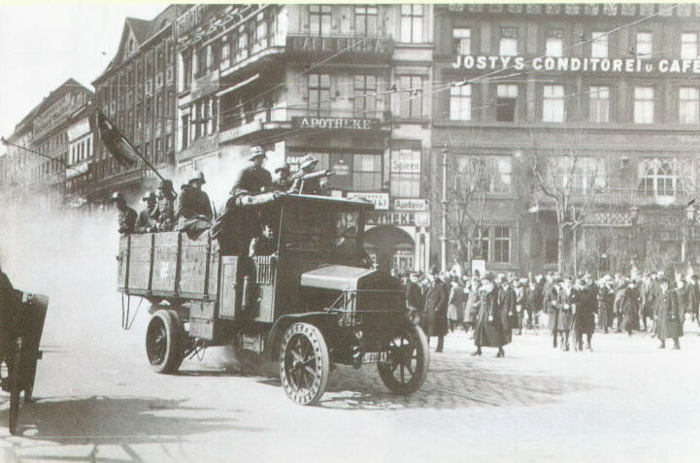
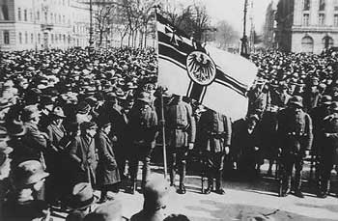
►On 13th March 1920, 5,000 Freikorps took over Berlin. The Berlin Police joined the Freikorps.
Ebert and the government had to leave the city.
A Kapp Putsch supporter declaring Kapp Germany’s new Chancellor.
Vehicles full of armed Freikorps driving around Berlin.
Kapp rally. On the flag is the symbol of the Kaiser.

Slide 7
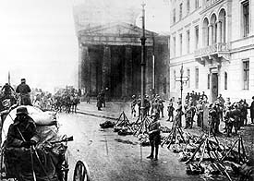
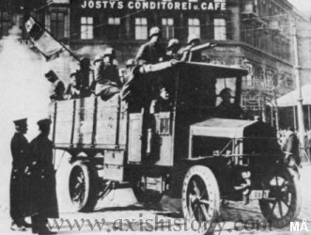
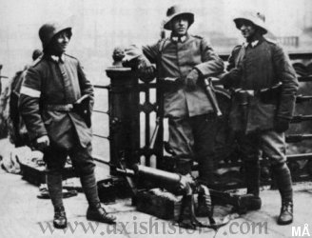
CLOSE CALL FOR EBERT!
The putsch failed because the workers of Berlin went on a general strike which brought the city to a standstill. There was no water, gas, coal and no trains or buses ran. Kapp knew he could not run Germany if the people did not support him!
5 days later, Kapp fled to Sweden. It had been another narrow escape for the new government.

Slide 8
TASK
Q1. Describe what a putsch is.
Q2. Who was Wolfgang Kapp? [left or right wing?] What did he want?
Q4. What group of people did Kapp use to take over Berlin? What was unusual about this?
Q5. The putsch lasted only 5 days, why? [Why did the putsch fail?]

Slide 9
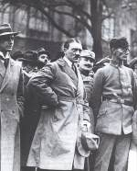
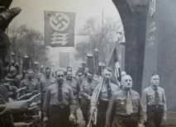
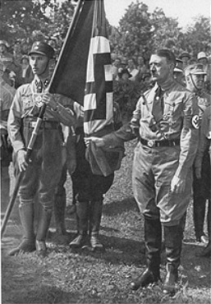
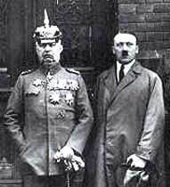
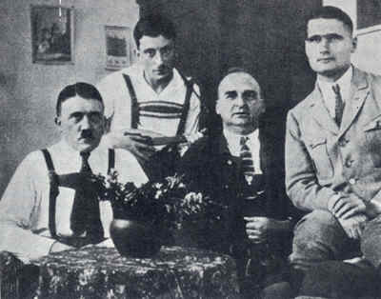
THE MOST FAMOUS PUTSCH WAS LED BY ADOLF HITLER IN Nov 1923.

Slide 10
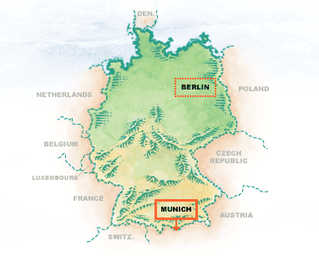
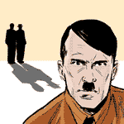
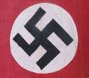
Hitler: The Munich Putsch [1923]
In 1923 the Nazis were a terrorist group. Hitler had a following of about 55,000 people. They were mainly unemployed young men and former soldiers. Hitler called them his known as storm troopers (the SA). They went around Germany attacking other political groups and trying to start a revolution to end the Weimar Republic.
The Munich Putsch is sometimes called the Beer Hall Putsch because it started in a Beer Hall!
Munich is in Bavaria in southern Germany.

Slide 11
Write in full sentences the answers to the following questions:
QUESTION 1: What kind of people were supporters of Adolf Hitler and the Nazi Party in 1923?
QUESTION 2: What is the best way to describe the Nazi Party in 1923? [A __________ group.]
QUESTION 3: What did the Nazi Party want?
QUESTION 4: What is another name for the Munich Putsch?

Slide 12
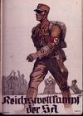
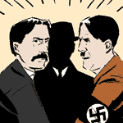
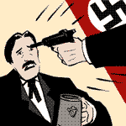
WHAT DID HITLER DO IN 1923?
On 8th November, 1923 Hitler and his Stormtroopers [SA] surrounded a beer hall in Munich. Inside the beer hall the Bavarian Governor Gustav Kahr was holding a meeting.
Hitler and 600 SA stormed inside and took Kahr into a side room. Waving a gun at him, Hitler forced Kahr to agree to rebel with him against the Weimar government...Kahr had to agree or be shot dead!

Slide 13
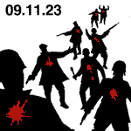
Hitler then dragged Kahr into the Beer Hall and told the people that Kahr was supporting the Nazis in a revolution. General Ludendorff then arrived to support Hitler. Ludendorff was a great War hero and when he was seen supporting Hitler, people in the beer hall started cheering in support.
The next day on the 9th November 1923, Hitler and his Nazis went into Munich on what they thought would be a triumphal march to take power. However, Kahr had called in police and army reinforcements. There was a short scuffle in which the police killed 16 Nazis. Hitler fled, but was arrested two days later and sentenced to 5 years in prison.

Slide 14
FILL IN THE BLANKS
On the ___ November there was a _________ in a beer hall in ________. Hitler forced himself into the meeting and held the leader _______ at gunpoint and forced him to agree to help him revolt against the government. General ___________ arrived and promised to support Hitler. He was a great _________ and people believed in him and so supported the Nazis too.
However, things went wrong on the next day. Kahr called the _________ and ______ and there was a shooting fight. _____ Nazis were killed and Hitler was ___________ and sentenced to _________ in prison for treason.
death 9th 6 years war hero Ludensow 26 police 8th army Berlin arrested 5 years meeting Kahr Munich Ludendorff 16 killed

Slide 15
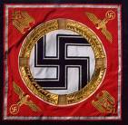
Why did Hitler attempt the Munich Putsch in 1923?
The Nazi party was stronger than ever before with 55,000 members. He wanted to take advantage of his peak support.
Hitler believed he would get help from politicians in Bavaria who he thought supported his idea of overthrowing the Weimar Republic. Hitler was wrong.
Hitler had a huge army of storm troopers and he knew he would lose control of them if he did not give them something to do!
Hitler hoped to copy Mussolini - the Italian fascist leader - who had come to power in Italy in 1922 by marching on Rome.
The Weimar Republic was in crisis over the reoccupation of the Ruhr and looked ready to collapse. Hitler wanted to take advantage of the weakness of the German government.

Slide 16
ANSWER THE QUESTION BELOW
Why did Hitler believe the time was ripe for a Nazi revolution in 1923?
- clues: 55,000 Nazi members, Bavarian politicians, restless Stormtroopers, Mussolini in Italy, crisis in the Ruhr.

Slide 17
THE RESULT OF THE FAILED PUTSCH
The Nazi party was banned, and Hitler was prevented from speaking in public until 1927.
Hitler went to prison, where he wrote 'Mein Kampf'. Millions of Germans read it, and Hitler's ideas became very well-known.
Hitler decided that he would never come to power by revolution and force. He realised that he would have to use legal and constitutional means to get to power.
Hitler began to organise and plan his route to power.
Hitler began to use propaganda campaigns to win supporters.
Later, Hitler decided to merge with other right-wing parties to get seats in the Reichstag.
Hitler formed the SS, his personal bodyguard in 1925 which was to become very useful to him in his quest for power.

Slide 18

QUIZ QUESTIONS
How many members did the Nazi party have in 1923? 5,500, 55,000 or 550,000.
Which of these is not an acceptable way of writing Hitler's paramilitary group? Starship Troopers, SA or Stormtroopers.
When did Hitler begin the Munich Putsch?
9th November 1919, 8th November 1923 or 9th November 1923.
What alternative name for the Munich Putsch reveals where Hitler began the rebellion?
Beer-Hall Putsch, Town-Hall Putsch or Beer-Garden Putsch.
How many Nazis were killed in the Munich Putsch? 16, 60 or 1,600.
Which of these was not a direct result of the Munich Putsch?
1). The Nazi Party was banned.
2). Hitler was banned from speaking in public.
3). Hitler wrote down his ideas in his book called ‘Mein Kampf’.
4). Hitler realised he would have to use propaganda campaigns to get support.
5). Hitler merged with other right-wing parties to get elected to power.

